Slide 1
Algorithm Analysis
Non-Recursive (Iterative)
ALGORITHM

Slide 2
Analysis of Algorithms
When we analyze algorithms, we should employ mathematical techniques that analyze algorithms independent of specific implementations, computers, or data.
To analyze algorithms:
  Count the number of significant operations
  Then, express the efficiency of algorithms using growth functions.

Slide 3
Algorithm Classification
There are various ways to classify algorithms:
  1. Classification by implementation :
    Recursion or iteration
    Serial or parallel or distributed
    Deterministic or non-deterministic
    Exact or approximate
  2.Classification by Design Paradigm :
    Divide and conquer.
    Dynamic programming.
    The greedy method.
    Linear programming.
    Reduction.
    Search and enumeration.
    The probabilistic and heuristic paradigm.

Slide 4
Time Efficiency of Non-recursive Algorithms
Steps in mathematical analysis of non-recursive algorithms:
Decide on parameter n indicating input size
Identify algorithm’s basic operation
Determine worst, average, and best case for input of size n
Set up summation for C(n) reflecting algorithm’s loop structure for running time[count value]
Find closed form for the sum or at least establish its order of growth by Simplifying summation using standard formulas

Slide 5
General Rules for Estimation
Loops: The running time of a loop is at most the running time of the statements inside of that loop times the number of iterations.
Nested Loops: Running time of a nested loop containing a statement in the inner most loop is the running time of statement multiplied by the product of the sized of all loops.
Consecutive Statements: Just add the running times of those consecutive statements.
If/Else: Never more than the running time of the test plus the larger of running times of S1 and S2.

Slide 6
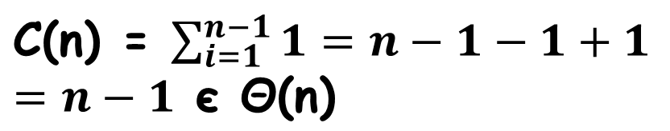
Analysis of Nonrecursive Algorithms
ALGORITHM MaxElement(A[0..n-1])
//Determines largest element
maxval ⬅ A[0]
for i ⬅ 1 to n-1 do
if A[i] > maxval
maxval ⬅ A[i]
return maxval
Input size: n
Basic operation: > or <-

Slide 7
Analysis of Non-recursive (contd.)
ALGORITHM Unique-Elements(A[0..n-1])
//Determines whether all elements are //distinct
for i <- 0 to n-2 do
for j <- i+1 to n-1 do
if A[i] = A[j]
return false
return true
Input size: n
Basic operation: A[i] = A[j]
Does C(n) depend on type of input?

Slide 8
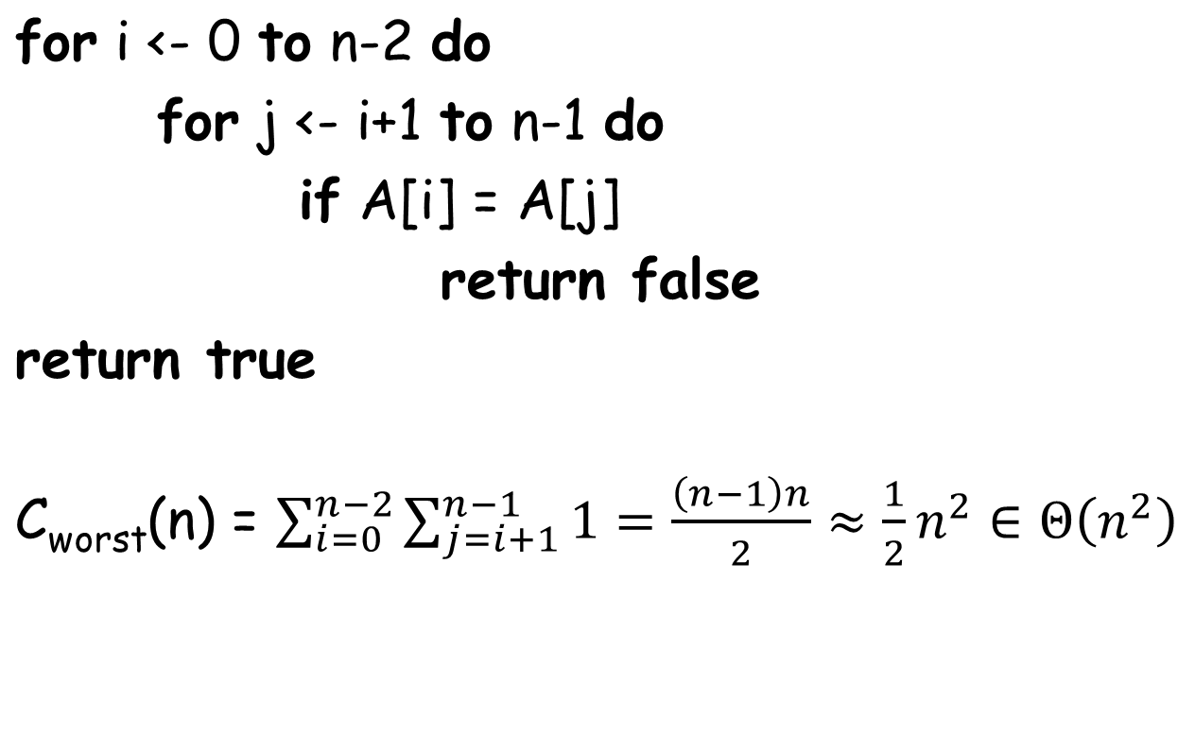
Unique Elements (contd.)

Slide 9
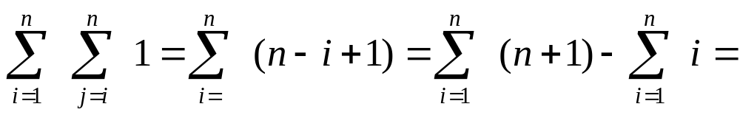
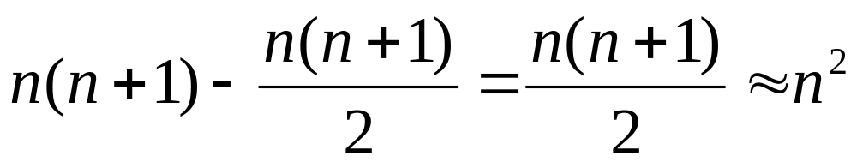
Nested Dependent Loops
for i = 1 to n do
for j = i to n do
sum = sum + 1
Notes:
There’s a little twist here. J goes from I to N, not 1 to N.
So, let’s do the sums
inside is constant.
Next loop is sum I to N of 1 which equals N - I + 1
Outer loop is sum 1 to N of N - I + 1
That’s the same as
sum N to 1 of I
or N(N+1)/2
or O(N^2)

Slide 10
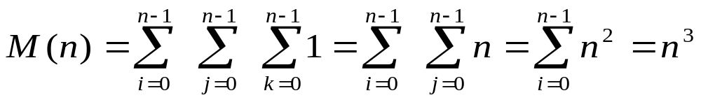
Analysis of Non-recursive (contd.)
ALGORITHM Matrix-Multiplication(A[0..n-1, 0..n-1], B[0..n-1, 0..n-1])
//Output: C = AB
for i ⬅ 0 to n-1 do
for j ⬅ 0 to n-1 do
C[i, j] ⬅ 0.0
for k ⬅ 0 to n-1 do
C[i, j] ⬅ C[i, j] + A[i, k]×B[k, j]
return C

Slide 11
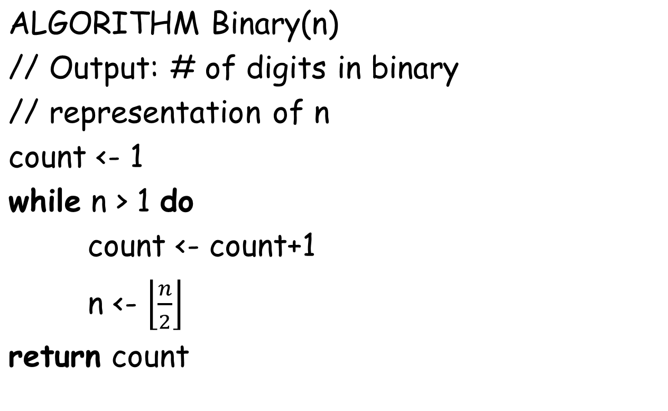
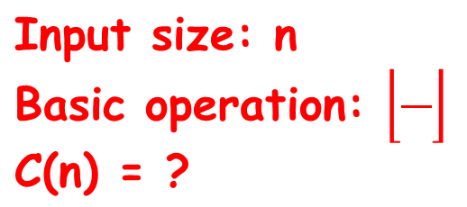
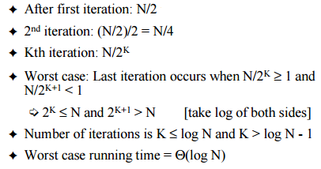
Analysis of Non-recursive (contd.)

Slide 12
Selection Sort
Input: An array A[0..n-1]
Output: Array A[0..n-1] sorted in ascending order
for i ← 0 to n-2 do
min ← i
for j = i + 1 to n – 1 do
if A[j] < A[min]
min ← j
swap A[i] and A[min]

Slide 13
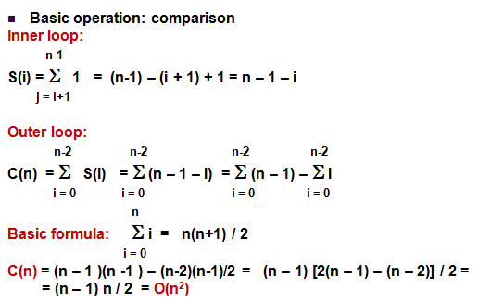

Selection sort Analysis

Slide 14
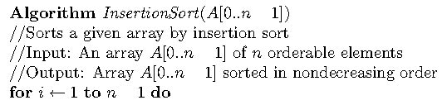
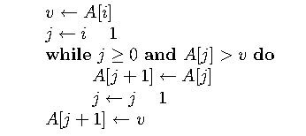
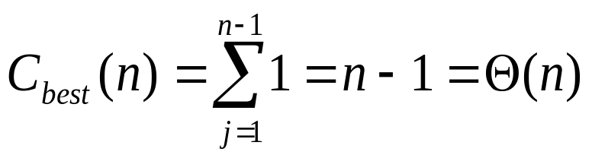
Insertion Sort
n = number of list elements
basic op = comparison
best case != worst case != average case
best case: A[j] > v executed only once on each iteration
Notes:
Q1: why not j > 0 for basic op?
Q2: what does the best case actually correspond to?

Slide 15
Matrix Algorithm
// Input: A matrix A[0..n-1, 0..n-1] of real numbers
for i ← 0 to n - 1 do
  for j ← i to n-1 do
    if A[i, j] ≠ A[j, i]
    return false
return true
What does this algorithm compute?
What is its basic operation?
What is its efficiency class?
Suggest an improvement and analyze your improvement

Slide 16
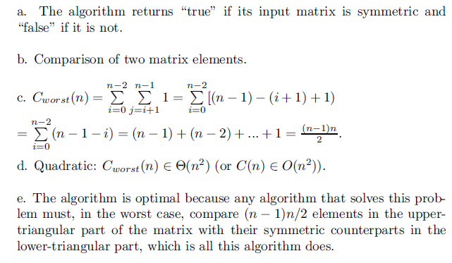
Matrix Algorithm

Slide 17
Analysis of Non-recursive
ALGORITHM sample(n)
S ⬅ 0
for i ⬅ 1 to n do
S ⬅ S + i×i
return S
What does this algorithm compute?
What is the basic operation?
How many times is the basic operation executed?
What’s its efficiency class?
Can you improve it further, Or Could you prove that no improvement is possible?

Slide 18
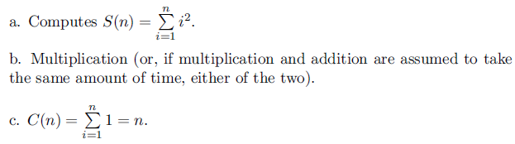
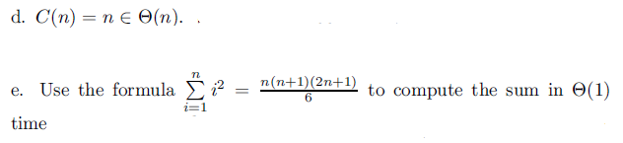
Analysis of Non-recursive Contd

Slide 19
Analysis of Non-recursive (contd.)
ALGORITHM Secret(A[0..n-1])
r ⬅ A[0]
s ⬅ A[0]
for i ⬅ 1 to n-1 do
if A[i] < r
r ⬅ A[i]
if A[i] > s
s ⬅ A[i]
return s-r
What does this algorithm compute?
What is the basic operation?
How many times is the basic operation executed?
What’s its efficiency class?
Can you improve it further, Or Could you prove that no improvement is possible?

Slide 20
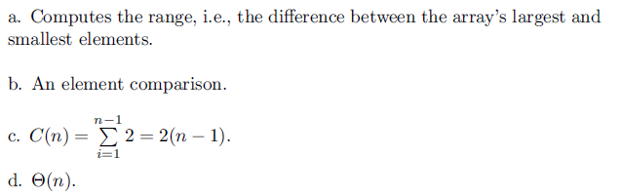
Analysis of Non-recursive (contd.)

